Slide 1

Enhancement of Health-care Services(Medi-care)
Innovative Solutions for Patients' Needs

Slide 2

Submitted To-
Dipayan Bhadra
(Adjunct Faculty)
Department of CSE
East West University
Submitted By-
Ayon Sen (2019-3-60-125)
Mujahidul Islam (2020-2-60-190)
Saurov Sikder (2021-1-60-053)
Anindita Sutradhar (2022-1-50-007)

Slide 3



Introduction
Benefits
Features
Insights
Medi-care transforms healthcare through real-time data analysis and predictive analytics, enabling swift, informed decisions and remote care delivery.
The platform offers seamless communication, personalized health info, and inclusive design, promoting patient engagement through easy access to records and resources.
Emphasizing equitable access, the system bridges care gaps and leverages data to reduce disparities, potentially improving overall population health outcomes.

Slide 4


Project Objectives
Develop real-time healthcare insights platform for Bangladesh
Empower patients with timely, relevant health data
Enhance care through provider-patient collaboration
Optimize treatment with data-driven insights
Promote prevention via personalized health recommendations

Slide 5
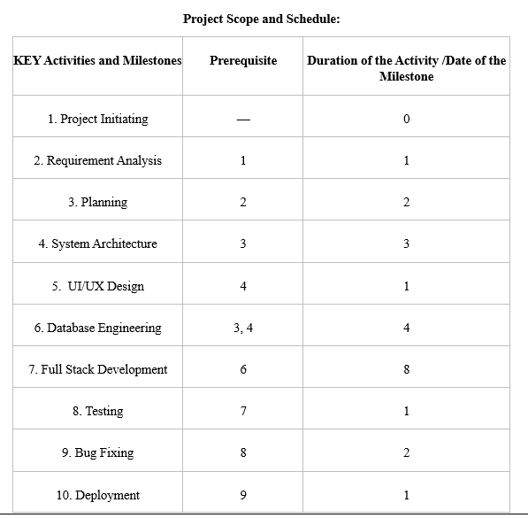
Project Scope and Schedule

Slide 6
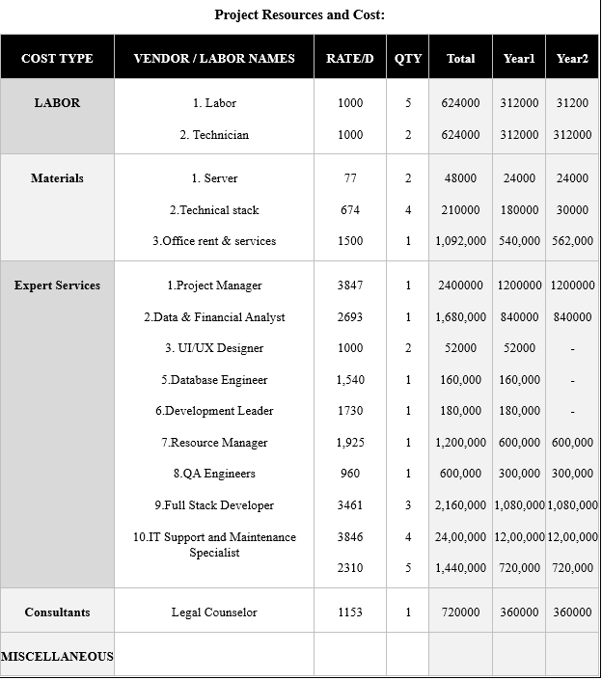
Project Resource Cost

Slide 7



Project Stakeholders
Internal Stakeholders
Extrenal Stakeholders
Project Owner
Project Manager
Database Engineer
Developer Team
Quality Assurance Team
Patients
Healthcare Providers
Investors
Medical Corporations
Legal Advisors
Payer Insurance Companies

Slide 8
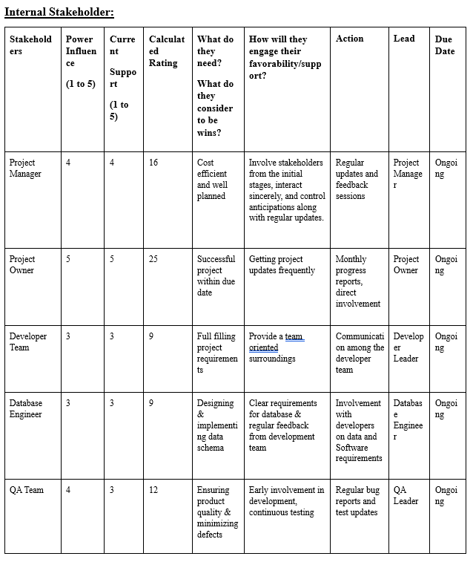
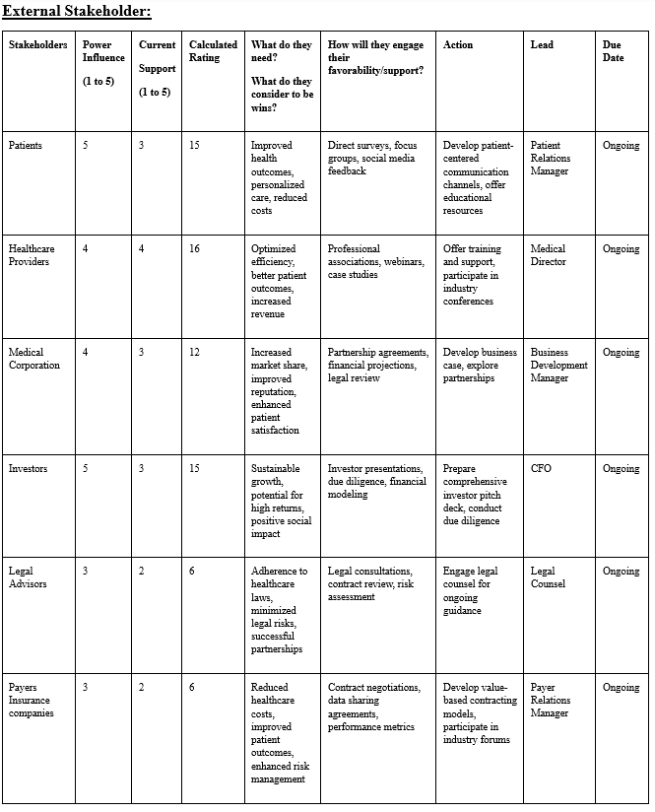
Project Stakeholder Analysis

Slide 9
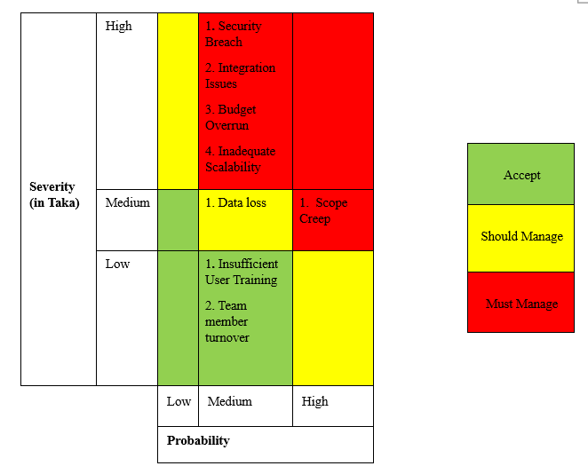
Risk Analysis

Slide 10
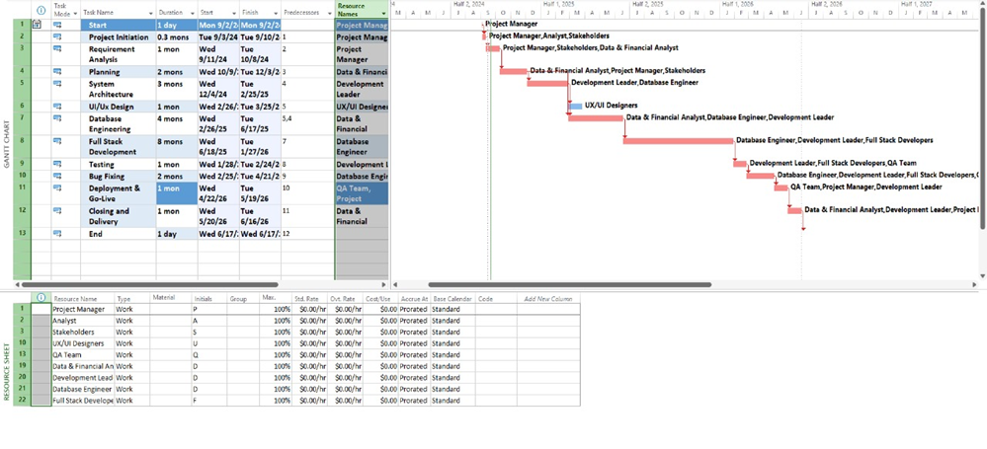
Gantt Chart

Slide 11

Project Appraisal
Net Present Value (NPV)
IRR
Benefit Cost Ratio (BCR)
Payback Period
Discount Payback Period

Slide 12
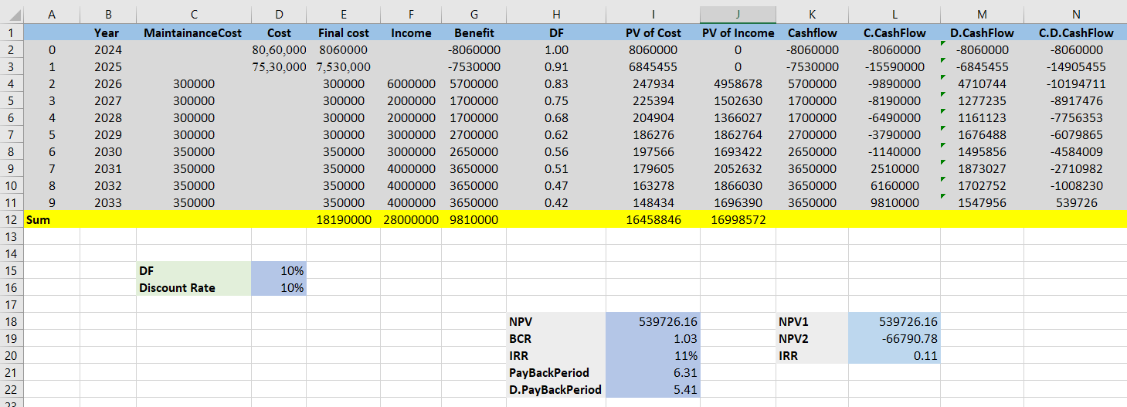
Cost Benefit Analysis

Slide 13


Discussion
NPV > 0
BCR > 1
IRR 11%
Payback Period 6 Years

